Slide 1
Chapter 1
1.1 Introduction to digital signals and systems, Properties
and operations on digital signals.
1.2 Classification of signals, system, LTI system
1.3 Convolution in time domain (linear & circular),
Correlation.
Self-Learning Topic: Correlation (Circular)

Slide 2
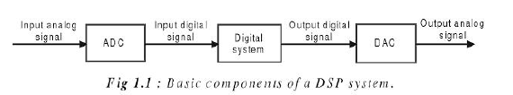

Slide 3
Signal
A signal is a pattern of variation that carry information.
Signals are represented mathematically as a function of one or more independent variable.
A picture is brightness as a function of two spatial variables, x and y.
In this course signals involving a single independent variable, generally refer to as a time, t are considered. Although it may not represent time in specific application.
A signal is a real-valued or scalar-valued function of an independent variable t.

Slide 4
Example of signals
Electrical signals like voltages, current and EM field in circuit
Acoustic signals like audio or speech signals (analog or digital)
Video signals like intensity variation in an image
Biological signal like sequence of bases in gene
Noise which will be treated as unwanted signal

Slide 5
Classification of Signal
Continuous-time and discrete-time signal
Analog and digital signal (time and amplitude)
(1) Continuous-time signal：
(2) Discrete-time signal：Discrete variable→Continuous amplitude
Time-domain discrete signals
(3) Analog Signal: Continuous variable→Continuous amplitude
Speech, Television, Time-domain continuous signals
(4) Digital Signal：Discrete variables→Discrete amplitude
Quantized discrete-time signals

Slide 6
Signal Processing
Representation, transformation and manipulation
of signals and the information they contain.
Signal operation include:
(1) Transform, filter, inspection, spectrum analysis;
(2) Modulation and coding;
(3) Analog Signal Processing;
(4) Digital Signal Processing.
Computer, Semiconduct and Information Science
→1960’s-1970’s

Slide 7
Processing of analog signal with digital methods
(1) Digitalized process for analog signals
x_{a}(t)
Sample
Quantizer
Coder
x(n)
(2) Digital processing method
x_{a}(t)
Filter
A/D
DSP
D/A
Filter
y_{a}(t)
x(n)
y(n)

Slide 8
Feature of Digital System
Advantages
(1) High accuracy: Floating point-8,16,32,64 bits
(2) High reliability: VLSI (analog: drift, calibration)
(3) Flexible: DSP, Software, FPGA, VHDL
(4) Easy to integrate
(5) Deal with high dimensional signals
(6) Low costs: reusable, reconfigurable
(7) Data logging
(8) Adaptive capability

Slide 9
Objective of Digital Signal Processing
Digital Signals
Manipulation
Digital filter
Measurement
Digital Signals
Spectrum analysis
Frequency division
Disturbance attenuation
(1) Selective of A/D → Signal representation - Sampling
(2) Manipulation and transform → feature extraction and analysis
(3) Noise process → Digital filter

Slide 10
Energy and Power
Signals corrupted by noise.
Energy and Power Spectrum useful to identify signal from noise.
Energy and Power spectrum can be calculated by using Fourier transform.

Slide 11
Power and Energy in a Physical System
The instantaneous power
The total energy
The average power

Slide 12
Power and Energy
By definition, the total energy over the time interval in a continuous-time signal is:
denote the magnitude of the (possibly complex) number
The time average power
By definition, the total energy over the time interval in a discrete-time signal is:
The time average power

Slide 13
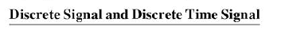
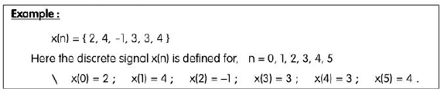

Slide 14
Discrete signal is function of discrete independent variable.
n is integer value of independent variable.
Discrete time signal
Here independent variable is n along with sampling time (T).

Slide 15
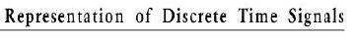
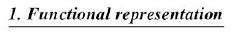
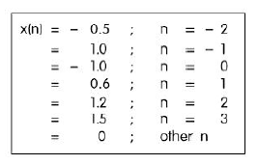

Slide 16
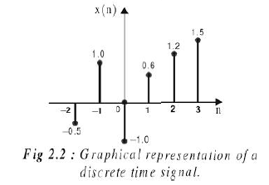

Slide 17
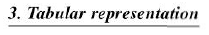
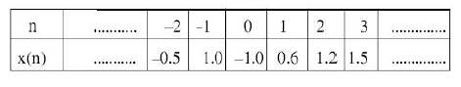

Slide 18
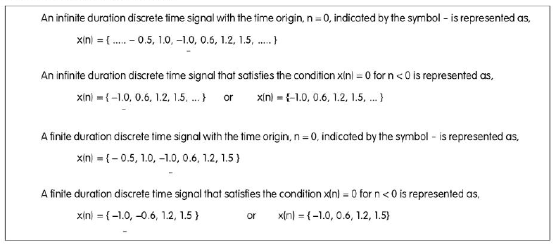
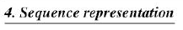

Slide 19
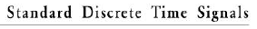
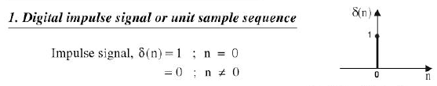

Slide 20
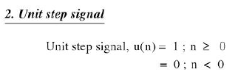
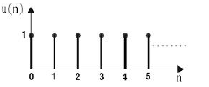

Slide 21
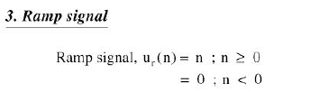
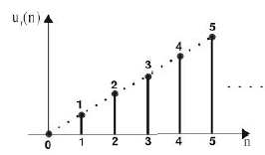

Slide 22
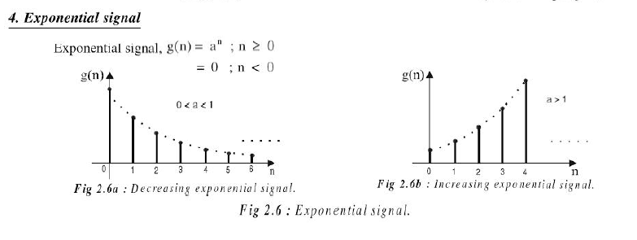

Slide 23
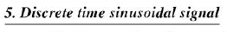
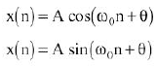
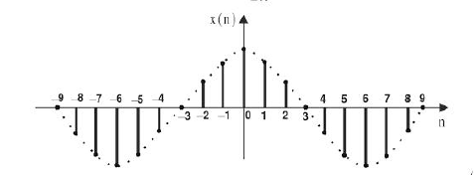

Slide 24
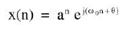
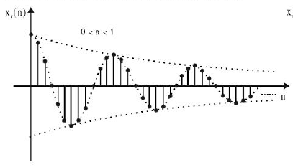

Slide 25
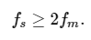
Sampling theorem
A continuous time signal can be represented in its samples and can be recovered back when sampling frequency f_{s} is greater than or equal to the twice the highest frequency component of message signal (fm).

Slide 26
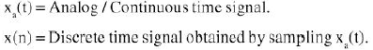
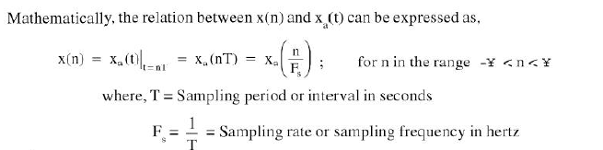
Relationship between analog and digital signal by sampling

Slide 27
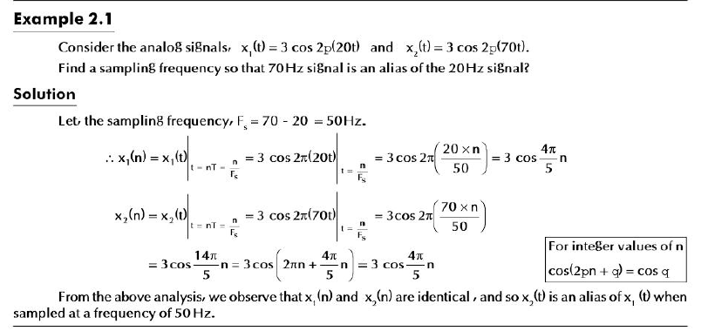

Slide 28
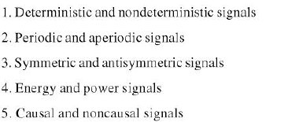
Classification of Discrete Time Signals

Slide 29
Deterministic and Random Signal
Signals specified by mathematical equations are deterministic signals
Eg: Ramp , Unit Step
Signals whose characteristics are random in nature are random signals
Eg: Noise

Slide 30
Periodic and Non-periodic
A discrete time signal is said to be periodic if the signal remains the same after left and right shifting operation by (k.N) or T
Where k is constant
N is fundamental time period of the signal
Both k and N are integer values

Slide 31
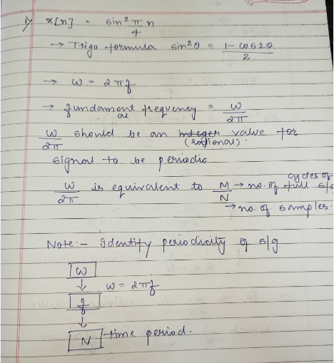

Slide 32
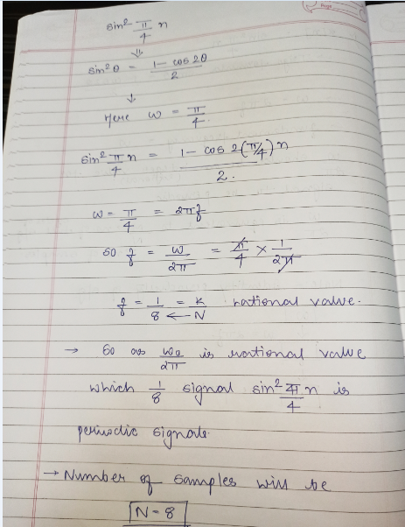

Slide 33
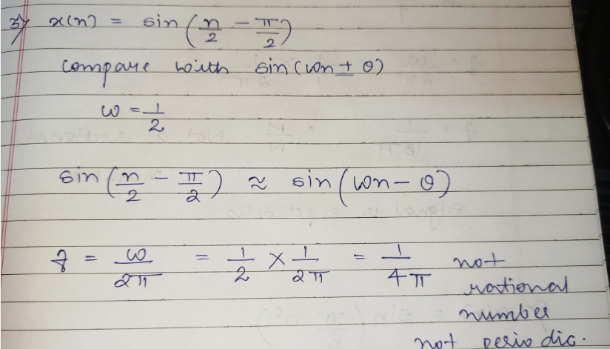

Slide 34
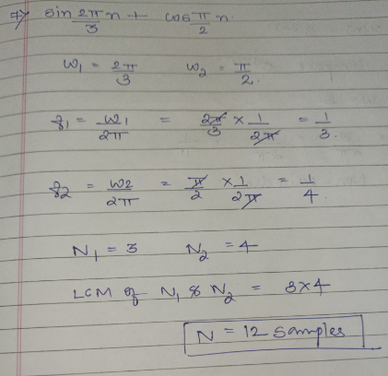

Slide 35
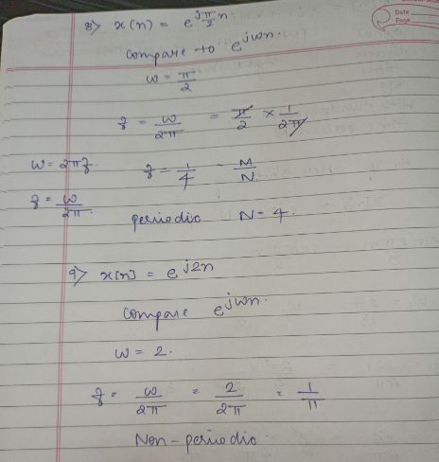

Slide 36
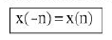
Even Signal: Discrete time signal exhibits symmetry with respect to n=0 it is even signal.
Even signal satisfies this condition

Slide 37
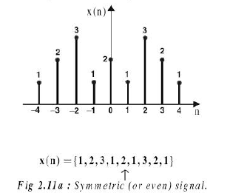

Slide 38
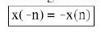
Odd Signal: Discrete time signal exhibits antisymmetric with respect to n=0 it is odd signal.
Even signal satisfies this condition

Slide 39
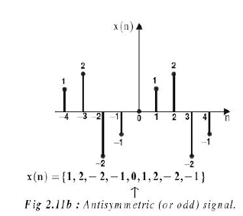

Slide 40
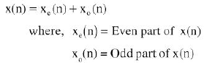
A discrete time signal is neither even nor odd is expressed as :

Slide 41
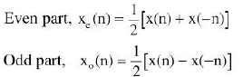
Calculation of Even and Odd part of the signal:

Slide 42
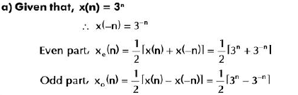

Slide 43
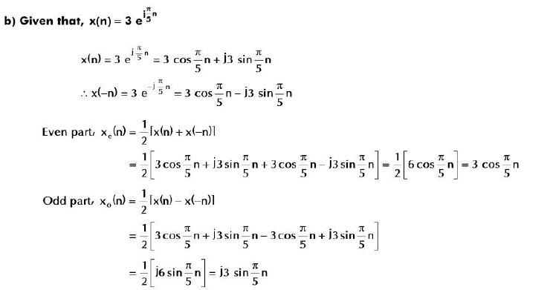

Slide 44
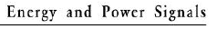
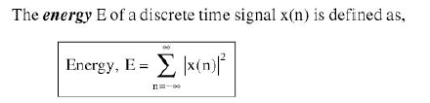
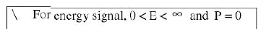
If energy of discrete time signal is finite and non zero then the signal is energy signal

Slide 45
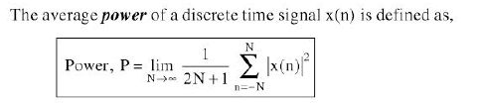
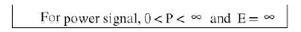
If power of discrete time signal is finite and non zero then the signal is power signal

Slide 46
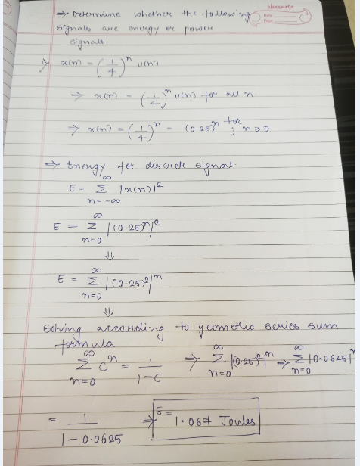

Slide 47
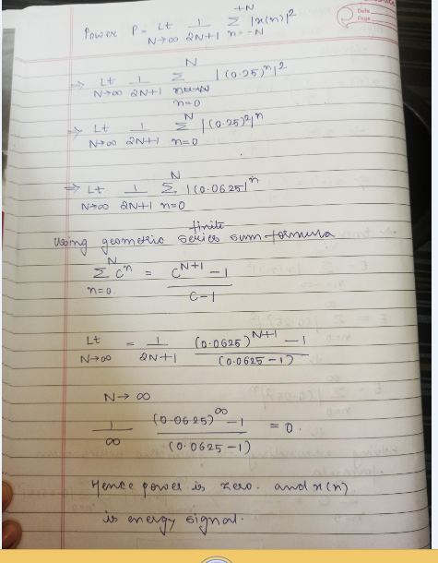

Slide 48
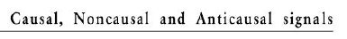
Causal Signal
Non Causal if defined for n<=0 or for both n>0 and n<=0
If system is non causal then:

Slide 49
Non causal discrete time signal only defined for n<=0 is called anti causal signal.

Slide 50
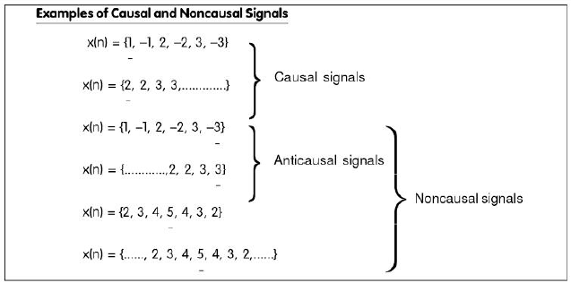

Slide 51


Slide 52


Slide 53
Downsampling = signal x(n) here n is replaced by Dn where D is an integer..
Upsampling = signal x(n) here n is replaced by n/I where I is an integer….

Slide 54


Slide 55


Slide 56


Slide 57


Slide 58
Time Shifting of Discrete Time Signals
X(n) signal will be shifted by variable m i.e. x(n)=x(n-m)
m is positive integer signal is delayed by m units of time.
Delay results in shifting each sample of x(n) to right.
m is negative integer signal is advanced by m units of time.
Advance results in shifting each sample of x(n) to left.

Slide 59


Slide 60

Addition of two discrete signals is performed on sample by sample basis.

Slide 61


Slide 62

Multiplication of two discrete signals is performed on sample by sample basis.

Slide 63


Slide 64
Discrete Time System
Discrete time system is device or algorithm which accepts input in discrete signal form to produce output or response in discrete time signal form.

Slide 65

Discrete Time System

Slide 66
LTI (Linear Time Invariant) System
A discrete time system is linear if it obeys principle of superposition and time invariant if input output relationship does not change with time.
When system satisfies property of linearity and time invariance it is called as LTI system.

Slide 67
Basic elements of Representation are:
Adder
Constant Multiplier – Constant scaling factor
Unit Delay Element – one sample unit to delay
Unit Advance Element - one sample unit to advance

Slide 68


Slide 70


Slide 71



Slide 72

Static System – Output depends on only current input samples but not on past or future samples – no memory
Dynamic System – Opposite of static

Slide 73


Slide 74


Slide 75
Time Invariant and Time Variant System
A system is said to be time invariant if its input output characteristics do not change with time.

Slide 76

Procedure to test for time Invariance

Slide 77

Procedure to test for time Invariance

Slide 78

Procedure to test for time Invariance

Slide 79


Slide 80


Slide 81


Slide 82
Linear and Non Linear System
Linear system satisfies superposition principle.
Response of system to weighted sum = weighted sum of responses of the system to each individual signals

Slide 83


Linear and Non Linear System(Check for Linearity)

Slide 84




Slide 85


Slide 86


Slide 87




Slide 88

Causal and Non Causal Systems

Slide 89
Causal and Non Causal Systems

Slide 90



Causal and Non Causal Systems

Slide 91
Causal and Non Causal Systems

Slide 92

Stable and Unstable

Slide 93

Stable and Unstable

Slide 94

Stable and Unstable

Slide 95
FIR and IIR Systems
FIR system (Finite duration Impulse Response System) , the impulse response consists of finite number of samples.
IIR system (Infinite duration Impulse Response System) , the impulse response consists of infinite number of samples.

Slide 96



Slide 97



Discrete or Linear Convolution

Slide 98
Discrete or Linear Convolution
In linear convolution the x1 and x2 sequences are non periodic , hence convolution result x3 is also non periodic.
Linear convolution is said to be aperiodic.

Slide 99


Slide 100


Slide 101


Slide 102


Number of Samples in output=N1+N2-1
N1 is number of samples in x(n)
N2 is number of samples in h(n)
Here 4+4-1= 7 samples for y(n)

Slide 103


Slide 104

Graphical Method

Slide 105


Slide 106


Slide 107


Slide 108


Slide 109


Slide 110


Slide 111


Slide 112


Slide 113


Slide 114



Slide 115


Slide 116


Slide 117

Circular Convolution

Slide 118

Circular Convolution

Slide 119


Slide 120


Slide 121


Slide 122


Slide 123


Slide 124


Slide 125


Slide 126


Slide 127


Slide 128


Slide 129


Slide 130


Slide 131


Slide 132


Slide 133


Slide 134


Slide 135


Slide 136
Correlation
Used when two signals are to be compared.
Measure of degree to which two signals are similar.
Cross Correlation – correlation of two separate signals
Auto Correlation – correlation of signal with itself.

Slide 137



Cross Correlation

Slide 138

Auto Correlation

Slide 139


Slide 140


Slide 141


Slide 142


Slide 143


Slide 144
Matrix Method for Calculating Auto and Cross Correlation.
Steps for Matrix Method Correlation
Take signal x(n) as it is.
Fold sequence y(n) to obtain y(-n).
Obtain convolution of x(n) and y(-n).
The result of convolution will be same as correlation.

Slide 145




Slide 146


